Slide 1
Culture of Lisianthus
by George Kester

Slide 2
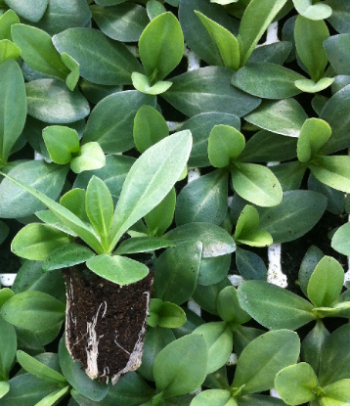
Young Plant
Ideal stage of transplanting is at 2 pairs of leaves.
Picture shows delivery stage for South Europe.
Delaying transplanting will result in poor
rooting, delayed flowering and shorter
flower stems.
Harden off the young plants at 15 degrees
for the last week.

Slide 3
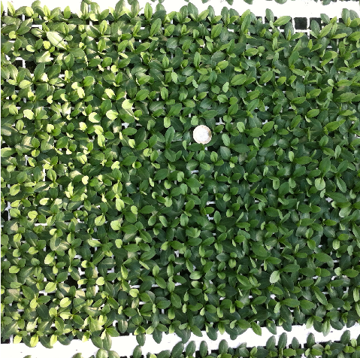
Growing young plants Stage Three: Days 42 – 70 (wk 6-10)
The plugs are approaching the transplant stage. ( South Europe and Poland 10 weeks old plant, Holland 12 weeks old, they do selecting in Holland in 10th week and recover for 2 weeks before delivering)
Young plants in Holland are much more stretched and more developed than plants for other area’s.
Provide the highest light possible within the optimum temperature range of 18-22C.
pH 6.0-6.5 and EC level between 0.7 and 1.0 pmm

Slide 4
Transplanting (day 70)
Soil & Bed Preparation
It is hilghly recommended to sterilize the soil before growing Lisianthus to get rid of pathogen like fusarium. If soil sterilization is not possible, select a soil where no Lisianthus were grown in the 3 years before. Allelopathy is also a great threat for growing Lisianthus on the same soil than last year..
Select a soil which is high in organic matter and which is free of pathogene.
Planting density Holland: +/- 81 per m2 (11 cm x 11 cm)
Planting density South Europe: between 40 and 60 per m2
Use of support netting is highly recommended
Day Length
Long days (>16 hours) accelerate growth and flowering. Howerver, not required!
Temperature
Minimum temperature is 15 degrees Celsius. Always ensure good ventilation (0.7 m/s)! This is very important to reduce diseases and tip burn.
Watering
Provide enough water, too dry cultivation will cause stress and rosetting.
Fertilizer
Provide a balanced fertilizer and adequate Ca levels.

Slide 5
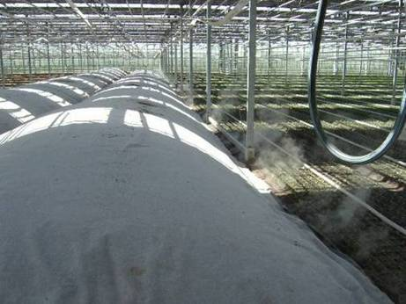
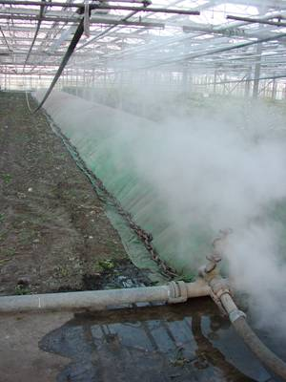
Transplanting (day 70)
Steam Sterilization
Cover the soil with a special sailing which keeps the heat inside. Put the heating pipes in and blow 100 C steam for 8 hours.

Slide 6
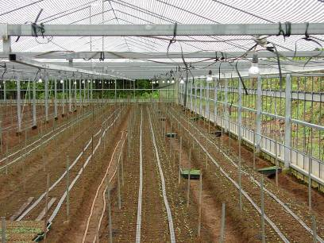
Transplanting (day 70)
Bed Preparation
Transplant between the 40 and 60 plants per m2.
Make sure the flower bed is well watered before transplanting!
pH of the soil should be between 6.0 and 6.8, soil should be high in organic matter.
Screen or chalk in summer after transplanting to avoid stress conditions.

Slide 7
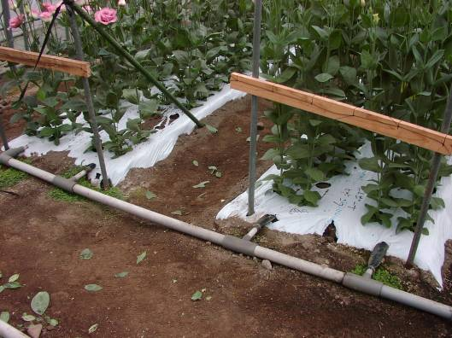
Cultivation (day 70-140+)
Watering
Provide enough water, overhead irrigation is sufficient.
Gradually lower watering when crop is closer to flowering (last 2-3 weeks).
Drip irrigation is usefull in later stages to prevent flower wilting, but not required.

Slide 8
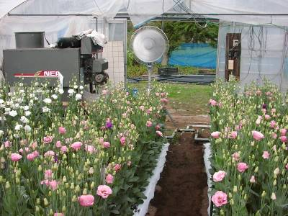
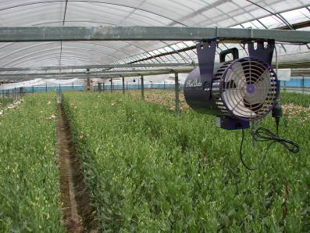
Cultivation (day 70-140+)
Temperature & Ventilation
Minimum temperature is 15 C
Ventilation is key!
0.7 m/s

Slide 9
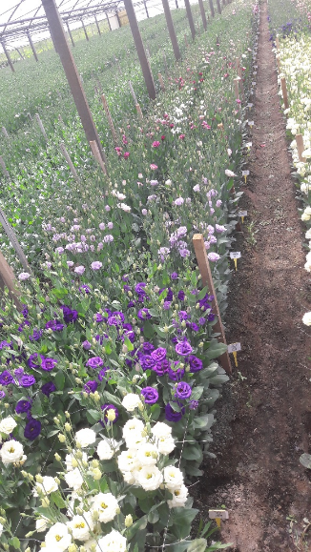
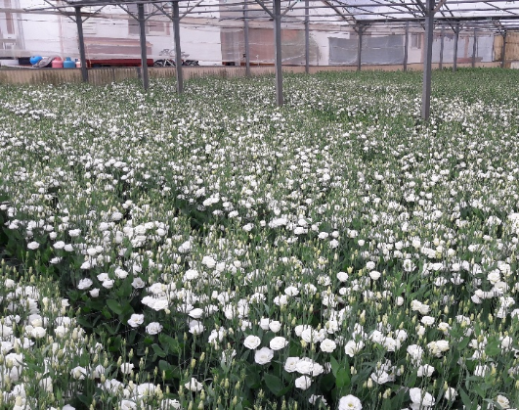
Cultivation (day 70-140+)
South Europe

Slide 10
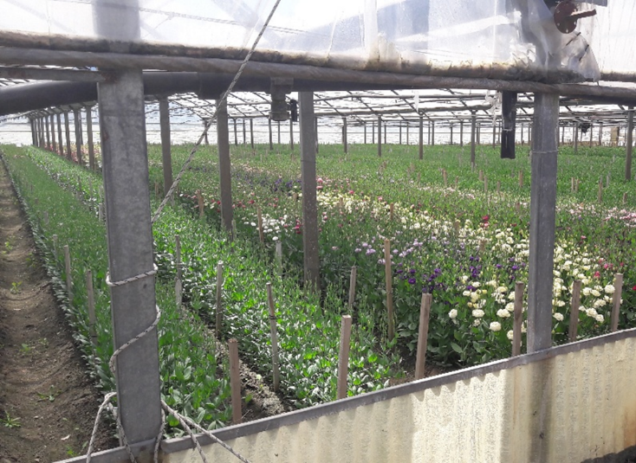
Cultivation (day 70-140+)
South Europe

Slide 11
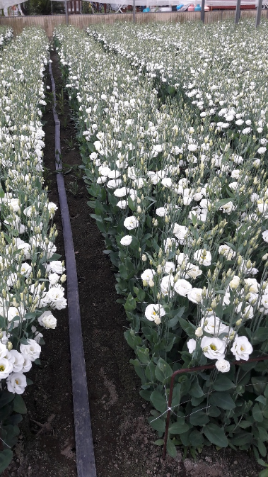
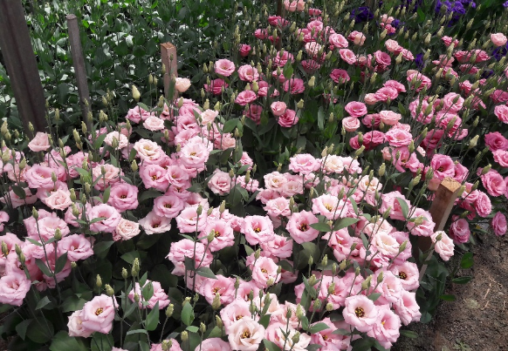
Cultivation (day 70-140+)
South Europe

Slide 12
Points of Attention
Ventilation and enough watering to avoid stress conditions and rosetting
Adequate spray program and make sure the greenhouse is free of weed to prevent from thrips
Fusarium is always present in air and soil, therefore it is important to sterelize the soil before cultivation. Besides, work as clean as possible in the greenhouse and use chemicals when needed to achieve a healthy crop.
Apply sufficient water in the first week after transplanting.

Slide 13
Crop Schedule
Group 0
Group 1
Winter Production
Fast variety, produces good length in period of low light intensity.
Group 2
Spring Production
Medium speed, produces good length at around 12 hours day light.
Group 3
Summer Production
Slow variety, needs a lot of light per day to produce good length. Ideal for summer production
Group 4
Summer Production
Very slow variety, needs a lot of light per day to produce good length. Produces very heavy stems. Ideal for hot summer conditions.

Slide 14
Crop Schedule
Crop Time: 13-15 weeks (depending on weather conditions)
Group | Planting weeks | Planting week
Group 0 | Week 48 - 6
Group 1 | Week 51 - 8 | Week 34 – 39
Group 2 | Week 4 – 15 | Week 32 – 37
Group 3 | Week 12 - 22 | Week 29 – 35
Group 4 | Week 19 - 31

Slide 15
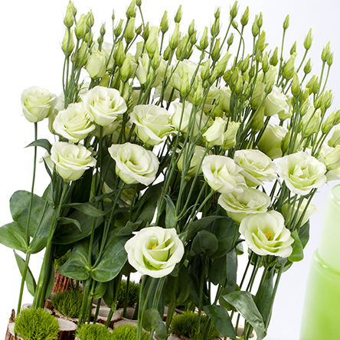
Following slides give some problems which can occur in Lisianthus Crop. Of course there are many things that can influence diseases and other problems, but in general are the problems with Lisianthus in every area or location the same.
Lisianthus issues and diseases

Slide 16
Environmental Effects
Temperature
Warmer temperature accelerates growth and flowering.
Temperature control is the most key issue.
The minimum temperature for growing Lisianthus is 15C.
Day length
Long day length accelerates growth and flowering.
Water and fertilizer
Water excess and fertilizer delay flowering.

Slide 17
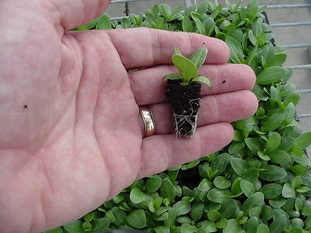
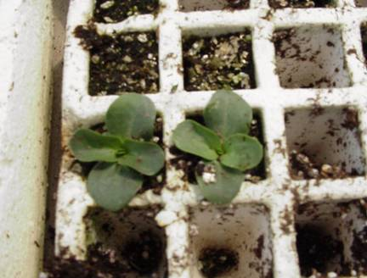
Rosetting - Plug Stage
Normal Plant
Rosetting Plant
Rosetting is actually now not a big problem anymore at the Dutch YPL growers. Because the conditions we have in Dutch YPL growers facilities are so balanced with Aircondition, and Short day threatment use, and the earlier mentioned cooling period just after sowing, all those adjustments in growing YPL’s of Lisianthus made the quality much better. But however in other countries those growing methods are not always used and therefore Rosetting can occur. The cooling period of the seeds during 4 weeks is necessarry …..when Rosetting occurs you can use Gibberellin to solve the problem.

Slide 18
Rosetting - Cut Flower bed
Induced dormancy (resting stage) often appears after plugs are transplanted into cut flower beds. But this problem is already initiated in the plug stadium. Cooling period after sowing is to avoid resetting.
Induced by stress conditions.(too hot, too dry…)
Nature’s way to ensure the survival of the species.
Nature can also be helped with a light spray of GA3 (Gibberellin) if necessary

Slide 19
Ventilation (0.7m/s)
Good ventilation for reduction of tip-burning and diseases, and acceleration of well-branched, tight flower stems . Ventilation is one of the key issues of growing Lisianthus

Slide 20
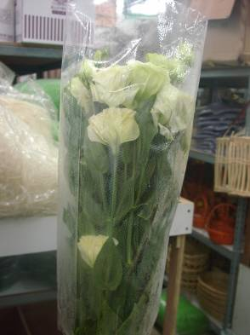
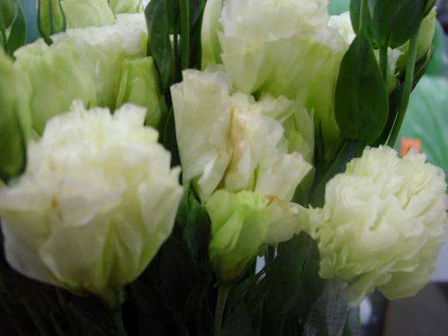
Packaging
Use hot needle sleeves to avoid flower botrytis

Slide 21
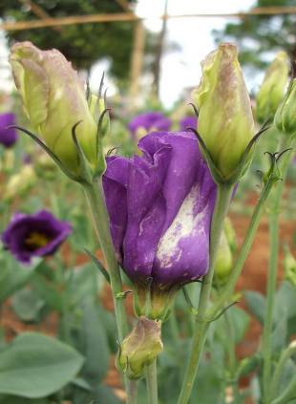
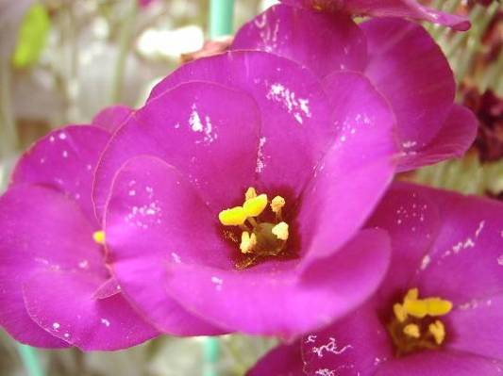
Pests - Thrips
Scratching of flower petals by thrips.
Weeds and greens around houses should be removed by implementing an effective spraying program.

Slide 22
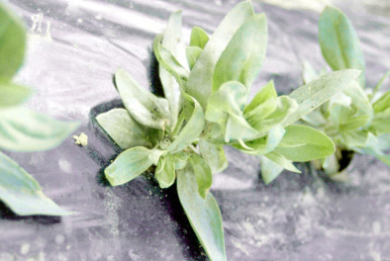
Pests - Thrips
A critical case of virus infection caused by aphids.
Weeds and greens around houses should be removed by implementing a effective spraying program. Destroy infected plants.

Slide 23
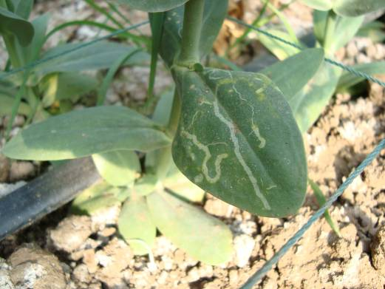
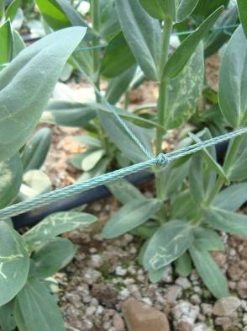
Pests - Leafminers

Slide 24
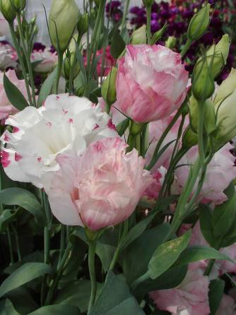
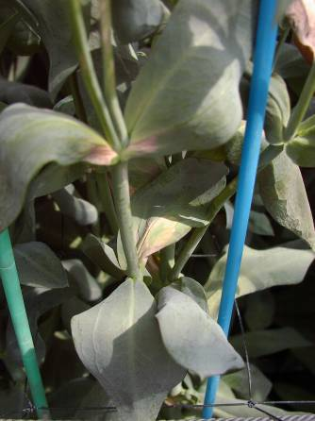
Viruses - INSV
Impatiens Necrotic Spot Virus

Slide 25
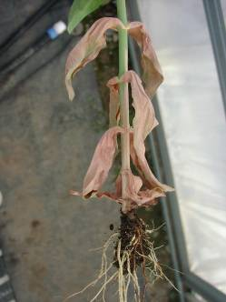
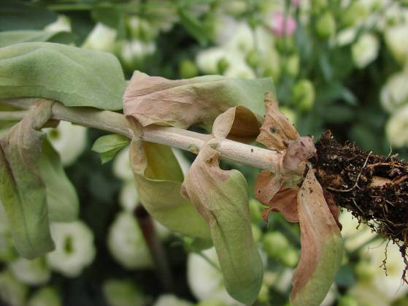
Diseases - Fusarium avenacium
Pinkish powder is one of the typical symptoms of Fusarium avenacium.
Fusarium is always present in the air and soil. So sterilization for example by Steam is necessary to clean the soil and kill all Fusarium elements. Despite the sterilization we have to work very clean in the Greenhouse and use chemicals to achieve a healthy crop.

Slide 26
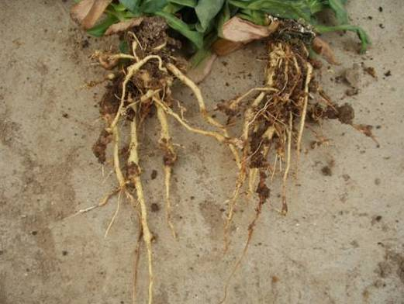
Diseases - Nematode
Occurs under soil conditions with too much nitrogen and immature compost.
Can be reduced by applying sufficient water after transplanting and during the early stages.

Slide 27
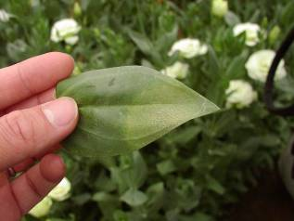
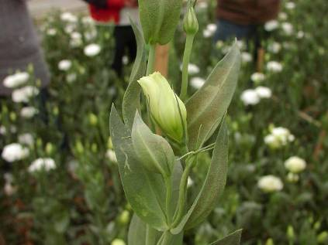
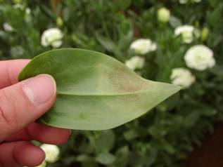
Diseases - Downy Mildew
Typical Downy Mildew symptoms, caused by high humidity with low temperature (10-15C), this is not a big issue in Holland at Forced Year round growers anymore because of high light levels and temperature….no chance for Downy Mildew to survive.

Slide 28
Lisianthus
Wide range of colours available
Wide range of flower types
High value end product
High number of flowers per stem
Excellent Vase Life: 20 days+
Possible to use in many
different ways

